Slide 1
Gene Analysis Project: Dasatinib-Resistant and Dasatinib-Sensitive Pancreatic Cancer Cell Lines
Presented by: Hayden Thomas

Slide 2
Introduction
The purpose of this presentation is to present the data analysis pipeline used on the publicly available GEO Dataset GSD5627: Dasatinib-Resistant and Dasatinib-Sensitive Pancreatic Cancer Cell Lines
The data analysis pipeline used includes methods for:
Sample outlier analysis and identification
Feature selection with two-sample t-test
Linear dimension reduction via principals of components analysis
Sample classification predicted by neural network

Slide 3
Background
The dataset was obtained from NCBI GEO DataSets database
Accession: GDS5627
The dataset pertains to the article: Activation of Protein Phosphatase 2A tumor suppressor as potential treatment of pancreatic cancer
(Chien,W. et.al, 2015)
The description of the microarray experiment is self-explanatory:
Analysis of gene expression for two cell lines
Cells lines include dasatinib-sensitive and dasatinib-resistant pancreatic cancer cells
Dasatinib is a kinase inhibitor which is approved by FDA for treatment of pancreatic cancer
Some pancreatic cancer cells have intrinsic or acquired resistance to this drug

Slide 4
Background Continued
This microarray experiment was conducted on an Illumina human microarray chip
Illumina HumanHT-12 V4.0 expression beadchip
Contains 48,107 probes – oligonucleotide beads
Single channel microarray
Contains 18 samples pertaining to two classes:
Organism: Homo sapiens, sample type: RNA
Dasatinib resistant
Dasatinib sensitive
Cell lines:
Sensitive: Panc0403,Panc0504,Panc1005
Resistant: SU8686, MiaPaCa2, Panc1
Should be noted that no control (non-cancerous cell type) was used

Slide 5
Data Pre-Processing: Sample Outlier Analysis

Slide 6
Data Pre-Processing: Sample Outlier Analysis

Slide 7
Data Pre-Processing: Sample Outlier Analysis

Slide 8
Feature Selection
This data set is predicated on two independent samples (drug resistant and drug sensitive pancreatic cancer cells)
I thought it would be best to perform a t-test and report out p-values. I went about doing this by two different methods:
I first found p-values for probes by two-sample students t-test; correcting by Bonferroni method
Then chose a threshold for choosing probes with p-values <= 0.05 giving a total of 17,980 probes
I then lowered the threshold for choosing probes with p-values <=0.01 giving a total of 10,148 probes
I then lowered the threshold one last time with p-values <= 0.001 giving a total of 3,766 probes
I felt the global p-values approach was too liberal so I then compiled a t-statistic list by looping a t-test 100 times, for each iteration the max t-statistic for each probe being stored into the list
From this list, I made the threshold the top 95 percentile of test statistics and chose probes with abs( test statistic) greater than this threshold. This left 510 probes
I then re-ran students t-test to generate p-values (correcting by Bonferroni method) for these 510 probes and used a final threshold of p-value <= 0.01, leaving 399 probes for feature selection

Slide 9
Feature Selection Visualizations

Slide 10
Linear Dimension Reduction

Slide 11
Sample Classification by Artifical Neural Network

Slide 12
Cell Class Prediction Table
Sensitivity = 100%
Specificity = 100%
Final Thoughts on prediction model:
Unrealistic to have perfect sensitivity and specificity
Small training set and testing set
Use of subset data to validate model

Slide 13
Top Five Genes Associated with Probes of smallest P-Values
Probe Gene Fold Change P-Value(adj.)
ILMN_1783337 DECR2 -0.9098388 5.522324e-06
ILMN_1682343 NONO 0.3381725 1.611060e-05
ILMN_3304086 ANAPC10 0.4805388 1.678626e-05
ILMN_1740772 APBB3 -1.1376750 1.816544e-05
ILMN_2403006 TJP1 1.5622788 2.140999e-05
Of Interest might be genes:
DECR2
APBB3
TJP1
Based on Fold Change and P-value

Slide 14
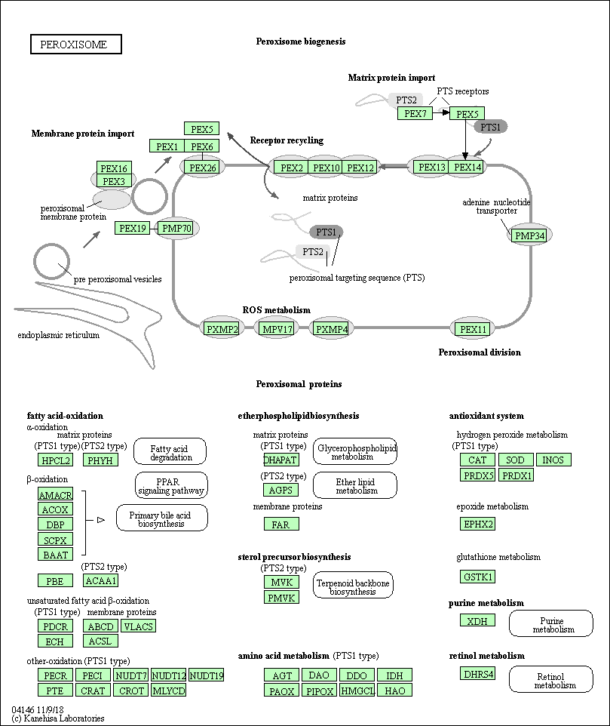
DECR2 Pathway Analysis
2,4-dienoyl-CoA reductase 2
GO:0006636
The chemical reactions and pathways resulting in the formation of an unsaturated fatty acid, any fatty acid containing one or more double bonds between carbon atoms.
GO:0005778
Peroxisomal membrane- the lipid bilayer surrounding a peroxisome.
GO:0008670
Involved in NADPH activity via the catalysis (reduction) of NADP+ to NADPH
Makes sense given that NADPH is implicated in lipid synthesis

Slide 15
References:
Chien W, Sun QY, Lee KL, et al. Activation of protein phosphatase 2A tumor suppressor as potential treatment of pancreatic cancer. Mol Oncol. 2015;9(4):889–905. doi:10.1016/j.molonc.2015.01.002
Torgo, L. (2010)Data Mining using R: learning with case studies, CRC Press (ISBN: 9781439810187)
Ashburner et al. Gene ontology: tool for the unification of biology. Nat Genet. May 2000;25(1):25-9
The Gene Ontology Consortium. The Gene Ontology Resource: 20 years and still GOing strong. Nucleic Acids Res. Jan 2019;47(D1):D330-D338
Kanehisa, M. and Goto, S.; KEGG: Kyoto Encyclopedia of Genes and Genomes. Nucleic Acids Res. 28, 27-30 (2000)
Kanehisa, M., Sato, Y., Furumichi, M., Morishima, K., and Tanabe, M.; New approach for understanding genome variations in KEGG. Nucleic Acids Res. 47, D590-D595 (2019)
Kanehisa, M; Toward understanding the origin and evolution of cellular organisms. Protein Sci. (2019)

